Slide 1


2023
Design Report

Slide 2


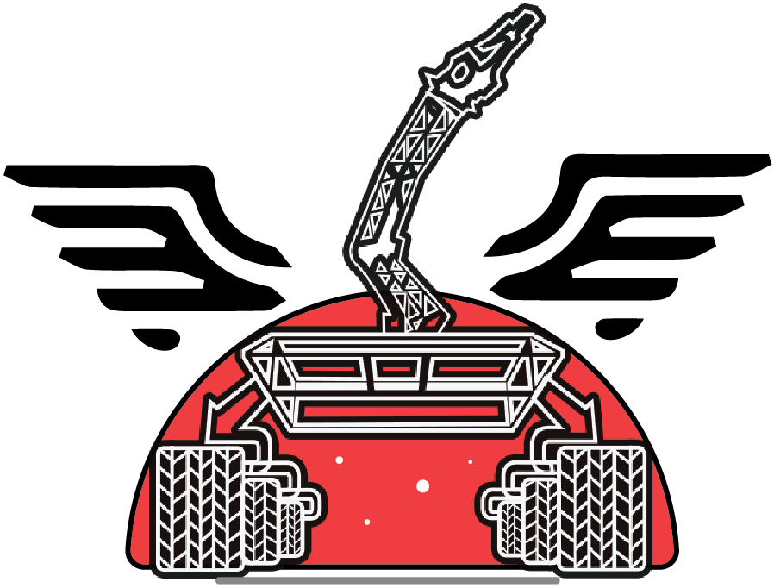
TEAM INFO
Team Name:
MIST Mongol Barota
Rover Name: Phoenix 3.0
Contact:
Email: mars.rover.mist@gmail.com
Contact No: +8801700808277
Team Lead(Md Rashid Ul Islam): +8801969844062
Academic Consultant(Lecturer Shah Md Ahasan Siddique): +8801710301593
Facebook Page: https://www.facebook.com/mongolbarota.mist
LinkedIn: https://www.linkedin.com/company/mist-mongol-barota

Slide 3
TEAM INFO
Academic
Institution:
Military Institute of Science and Technology(MIST)
Mirpur Cantonment, Dhaka, Bangladesh
1. Lt Col Muhammad Nazrul Islam, PhD
Associate Professor, Department of CSE ,Military Institute of Science and Technology(MIST)
Email: nazrul@cse.mist.ac.bd
Phone: +8801725560099
2. Shah Md Ahasan Siddique
Lecturer,Department of ME ,Military Institute of Science and Technology(MIST)
Email: ahasan.sid42@gmail.com
Phone: +8801710301593
Academic
Consultant:

Slide 4
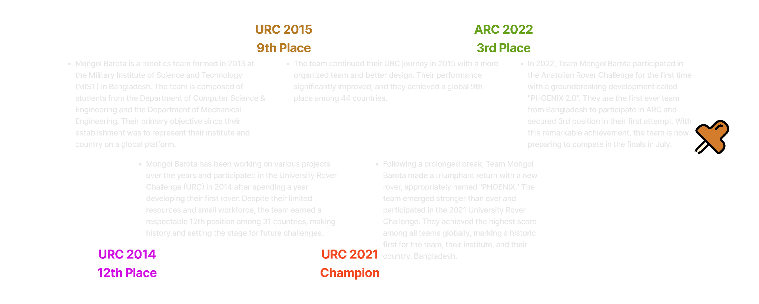
TEAM INFO
History of the Team:

Slide 5
TEAM INFO
Name | University Major | Role
Md Rashid Ul Islam | CSE | Team Lead
Ridwanul Islam Antu | ME | Team Co-lead
Md Jawadur Rahman | CSE | Electrical Lead
Mansib Hasan Rohan | EECE | Electrical
Sheikh Easin Arafat | CSE | Communication Lead
Nahidur Zaman Tushar | CSE | Electrical
Md Rifat Islam | CSE | Electrical
Arr Rafi | CSE | Electrical
Shoyeb | CSE | Electrical
Shakil Mosharraf | CSE | Software Lead
Raisul Islam Ruhad | CSE | Communication & Software
Shekh Md Saifur Rahman | CSE | Communication & Software
Yusuf Reza Hasnat | CSE | Communication & Software
Nabiha Parvez | CSE | Communication & Software
Mehnaj Hridi | CSE | Communication & Software
Tanvir Sarkar pallab | CSE | Communication & Software
Farhan Nasif Nizami | CSE | Communication & Software
Hafsah Mahzabin Chowdhury | CSE | Science
Sadia Nur Nazifa | CSE | Science Lead
Reefa Tasnia | CSE | Management
Active
Members List:

Slide 6
TEAM INFO
Name | University major | Role
Rakesh Majumder | EWCE | Science
Anika Tahsin Raisa | EWCE | Science
Sanzida Afrin Oishy | BME | Science
Sahran Akif Nizami | BME | Science
M N Alam Siddiqui | CSE | Management Lead
Mayeesha Musarrat | CSE | Management
Maisha Tabassum | CSE | Management
Raiyan Ahmed | ME | Management
Maliha Farhin Chhoa | ME | Management
Nazmul Hasan Fahim | ME | Mechanical Lead
Ahmed Ahnaf Saqafi | ME | Mechanical
Alamin Rashid Tarek | ME | Mechanical
MD Mehedi Hasan | ME | Mechanical
Saymoon Zaman Sayeem | ME | Mechanical
Aabritti Rafa | ME | Mechanical
Jinia Eva | ME | Mechanical
Md. Munam Shahriar Sabir | ME | Mechanical
Abrar Faiyaz Khan | CSE | Communication
Progga Roy | CSE | Science
Sifat Bin Asad | CSE | Electrical
Active
Members List:

Slide 7
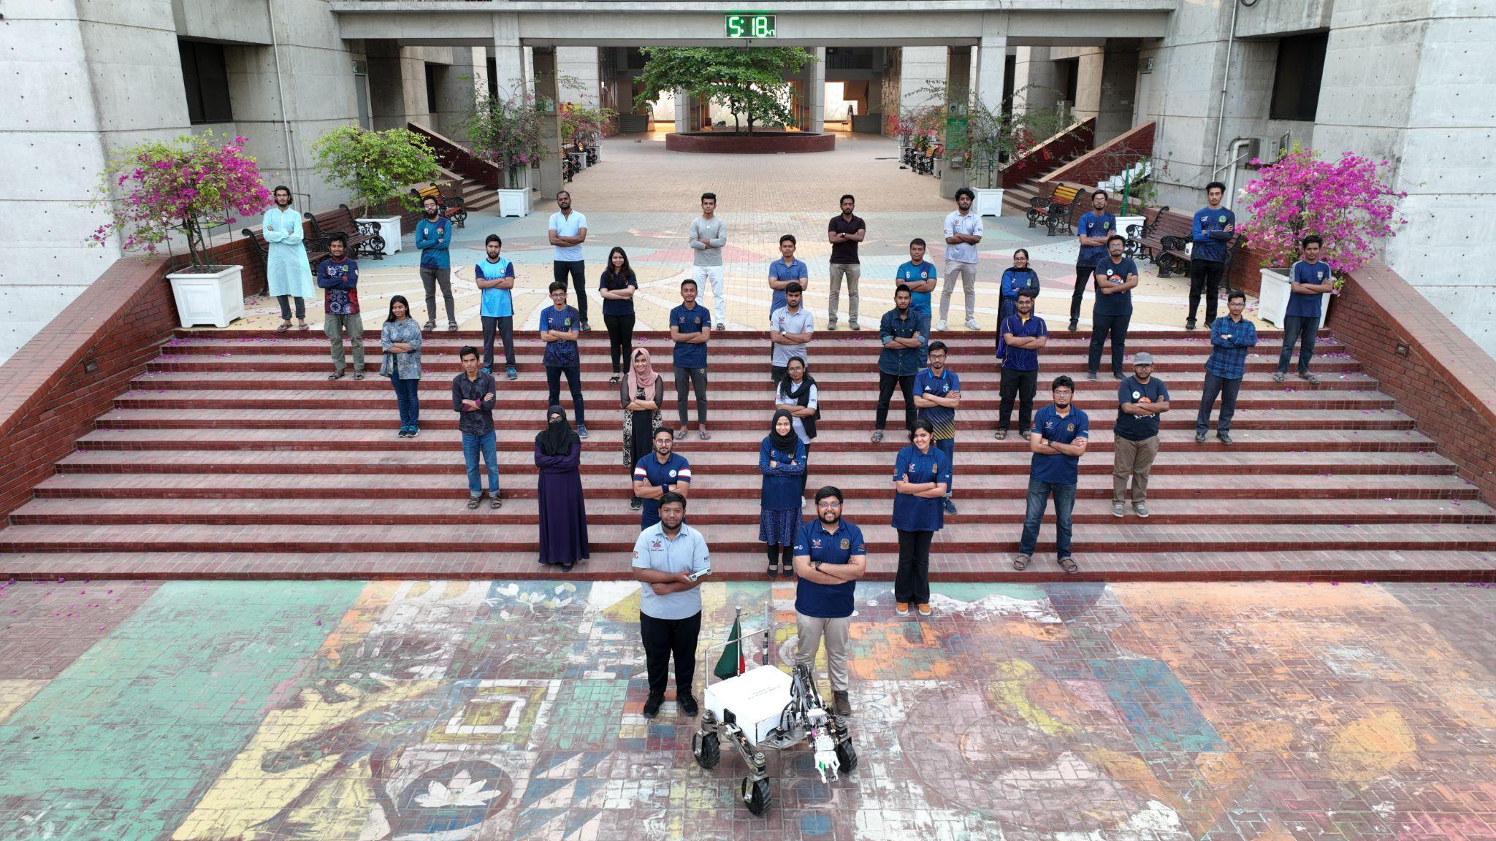
TEAM INFO
Team Photo

Slide 8

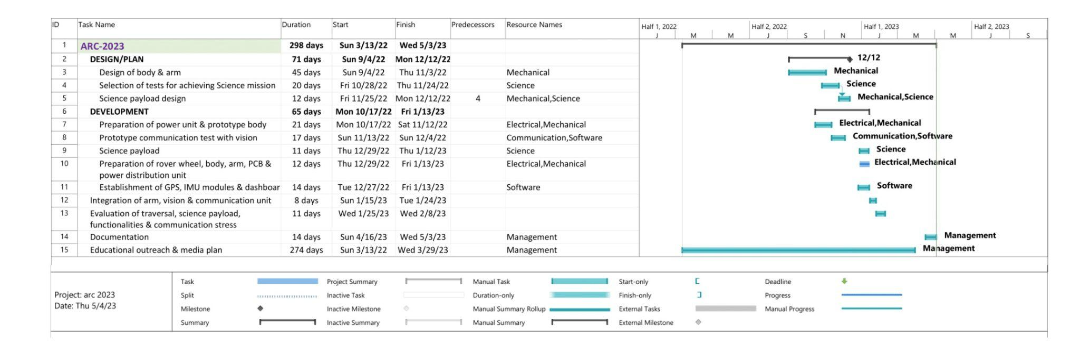
MANAGEMENT
Work Calendar:

Slide 9
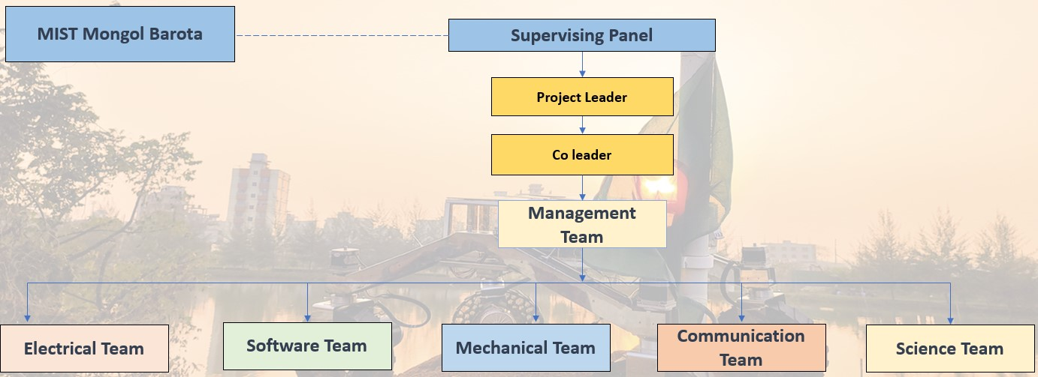
MANAGEMENT
Team
Formation:
Our team comprises over 45 members from diverse backgrounds and skill levels, organized into five sub-teams: Mechanical, Electrical, Software & Communication, Science, and Management, under the guidance of the Project Leader and co-Leader. Since the team's inception last year, it has grown significantly and now includes members with varying levels of experience and expertise. A detailed organogram of MIST Mongol Barota has been provided in a figure, illustrating the essential team members' fields of expertise and backgrounds.

Slide 10
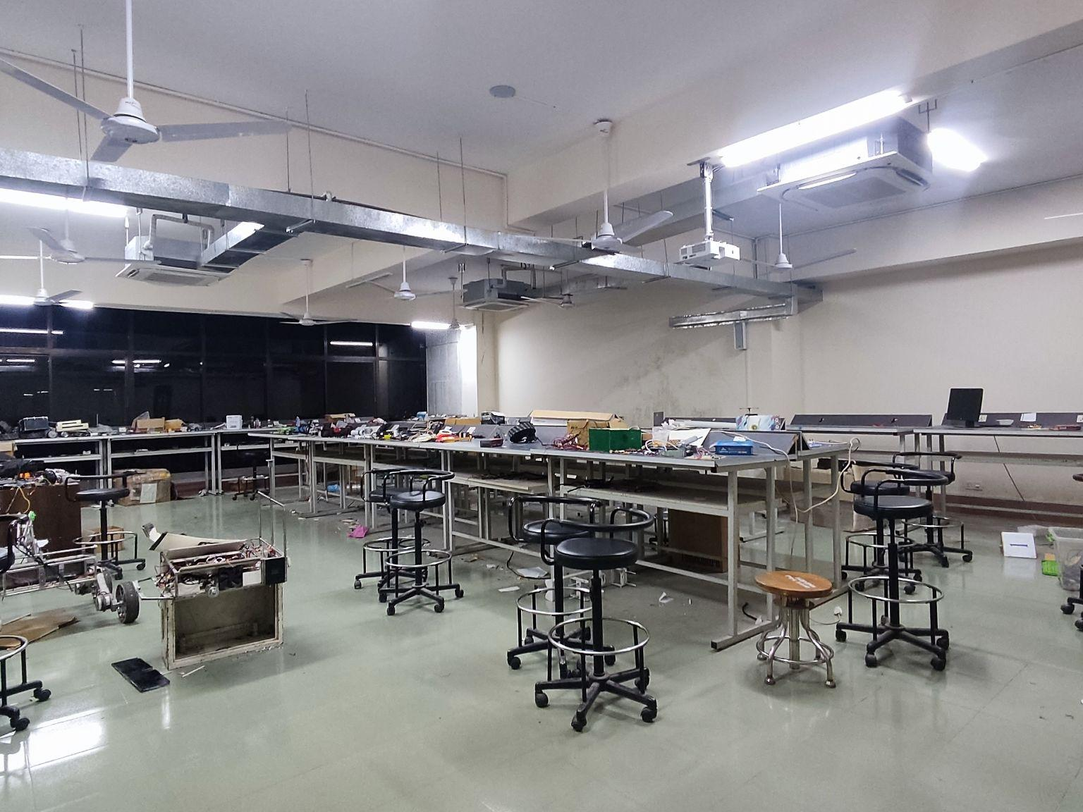
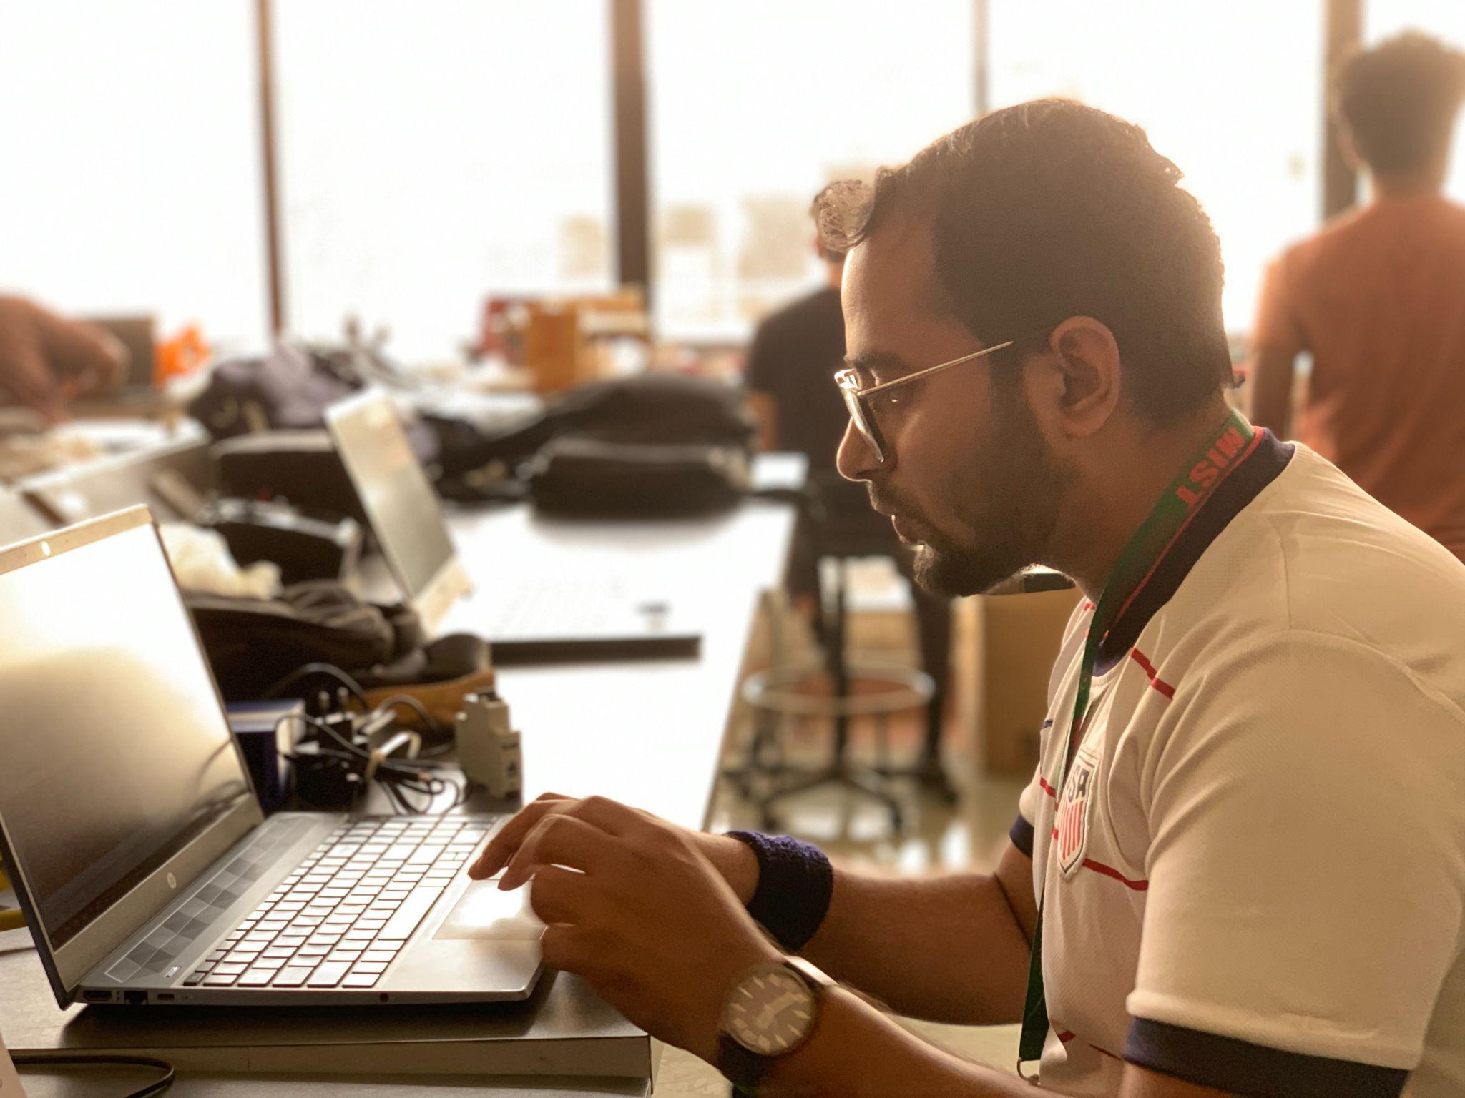
MANAGEMENT
Workplace:
We have a dedicated labs only for the MIST MONGOL BAROTA team. We use our campus field for different kinds of field tests too. Moreover, there are some spacious construction places near our campus where we perform our field tests sometimes.

Slide 11
MANAGEMENT
Funding :
Initially we had a fund of 55,000USD and we have already spent 18,000 USD for the development costs. The rest of the amount is kept for further tests and practice and for the competition.
We are expecting 20,000 USD for the development costs which includes Rover Body (Including Arm & Science Payload), processing & Control Modules, Communication, Navigation modules, Science modules, Rover vision and Power Resources.
Our team has enough funds to visit Turkey physically for participating in ARC 2023. We expect 17000 USD for travelling costs for 14 members.
Our rover is completely functional and we are all set to participate in the upcoming ARC. Even after that, if an insufficient funding situation occurs, then we have a dedicated budget for this type of Research & Development Project. However traditionally Industries, Banks etc. always respond to sponsorship proposals from our university. We have already sent the sponsorship proposal forms and got good responses, so we can take help from them if needed.

Slide 12
MANAGEMENT
Logistics:
To ensure timely and reliable transportation of the rover, we have decided to divide it into several modules and carry them in our personal luggage. This approach allows for easy assembly and disassembly of the rover, and we have found it to be more efficient than using shipping services, which can take longer.

Slide 13

ROVER DESIGN
Mobility
System:
For the suspension system, we used a Rocker bogie mechanism with a bevel gear differential system to absorb both frontal and rear impacts. Steerable wheel subsystem is equipped with a stepper motor and thrust bearing. Apart from this, our wheel is made of 3D printed honeycomb structure tires using thermoplastic polyurethane material.
Instead of Ball joints, this year we used bevel gear which keeps the whole system compact thus preventing wastage of space. Besides rocker bogie suspension was used for better stability. Steerable wheel subsystem ensured better maneuvering and precise movements of the rover. Thrust bearing has been implemented to carry the axial load to the wheel. Moreover, the rocker arm is made of stainless steel for better strength.

Slide 14
ROVER DESIGN
Mobility
System:
The Customized Wheel System ensured better traction and compliance while traversing challenging desert terrain. The honeycomb structured non pneumatic tires ensured better shock absorption. In addition to this, the rover is capable of climbing stairs. The bevel gear mechanism and steerable wheel system have been inspired from the Mars 2020 Perseverance rover.

Slide 15
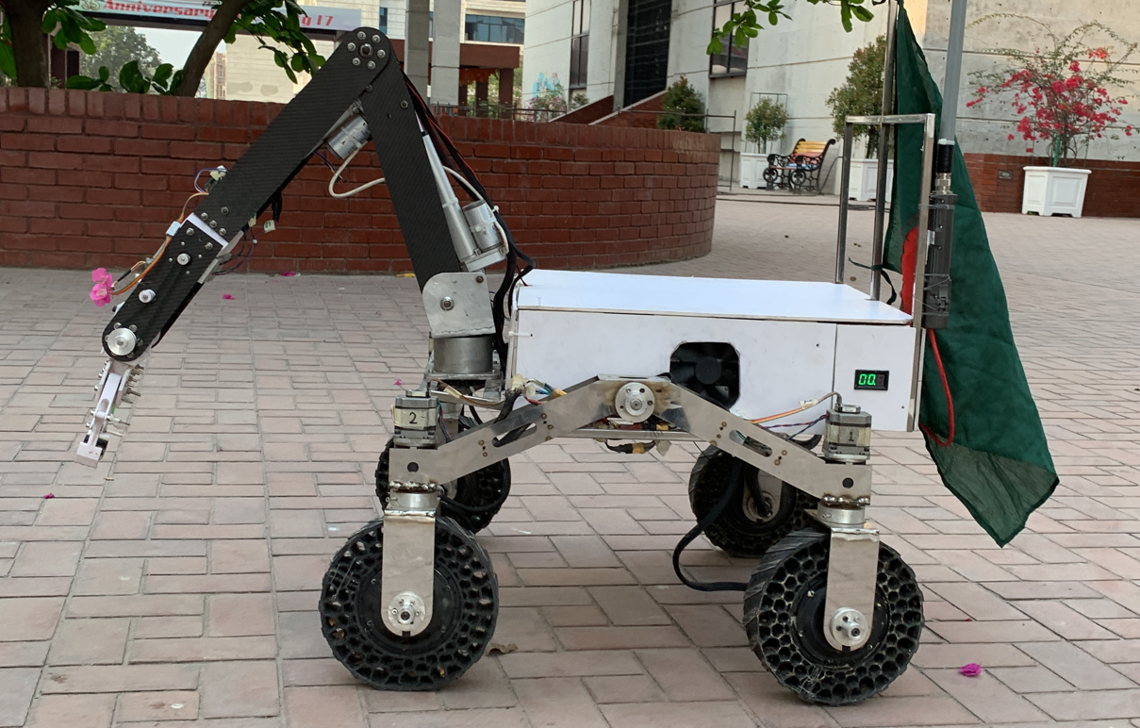
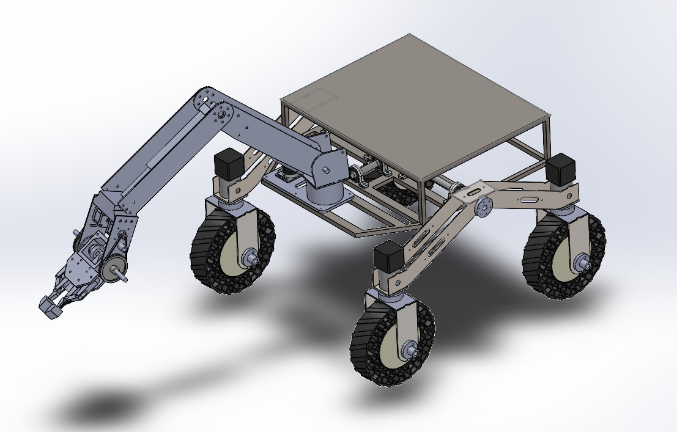
ROVER DESIGN
Mobility
System:

Slide 16
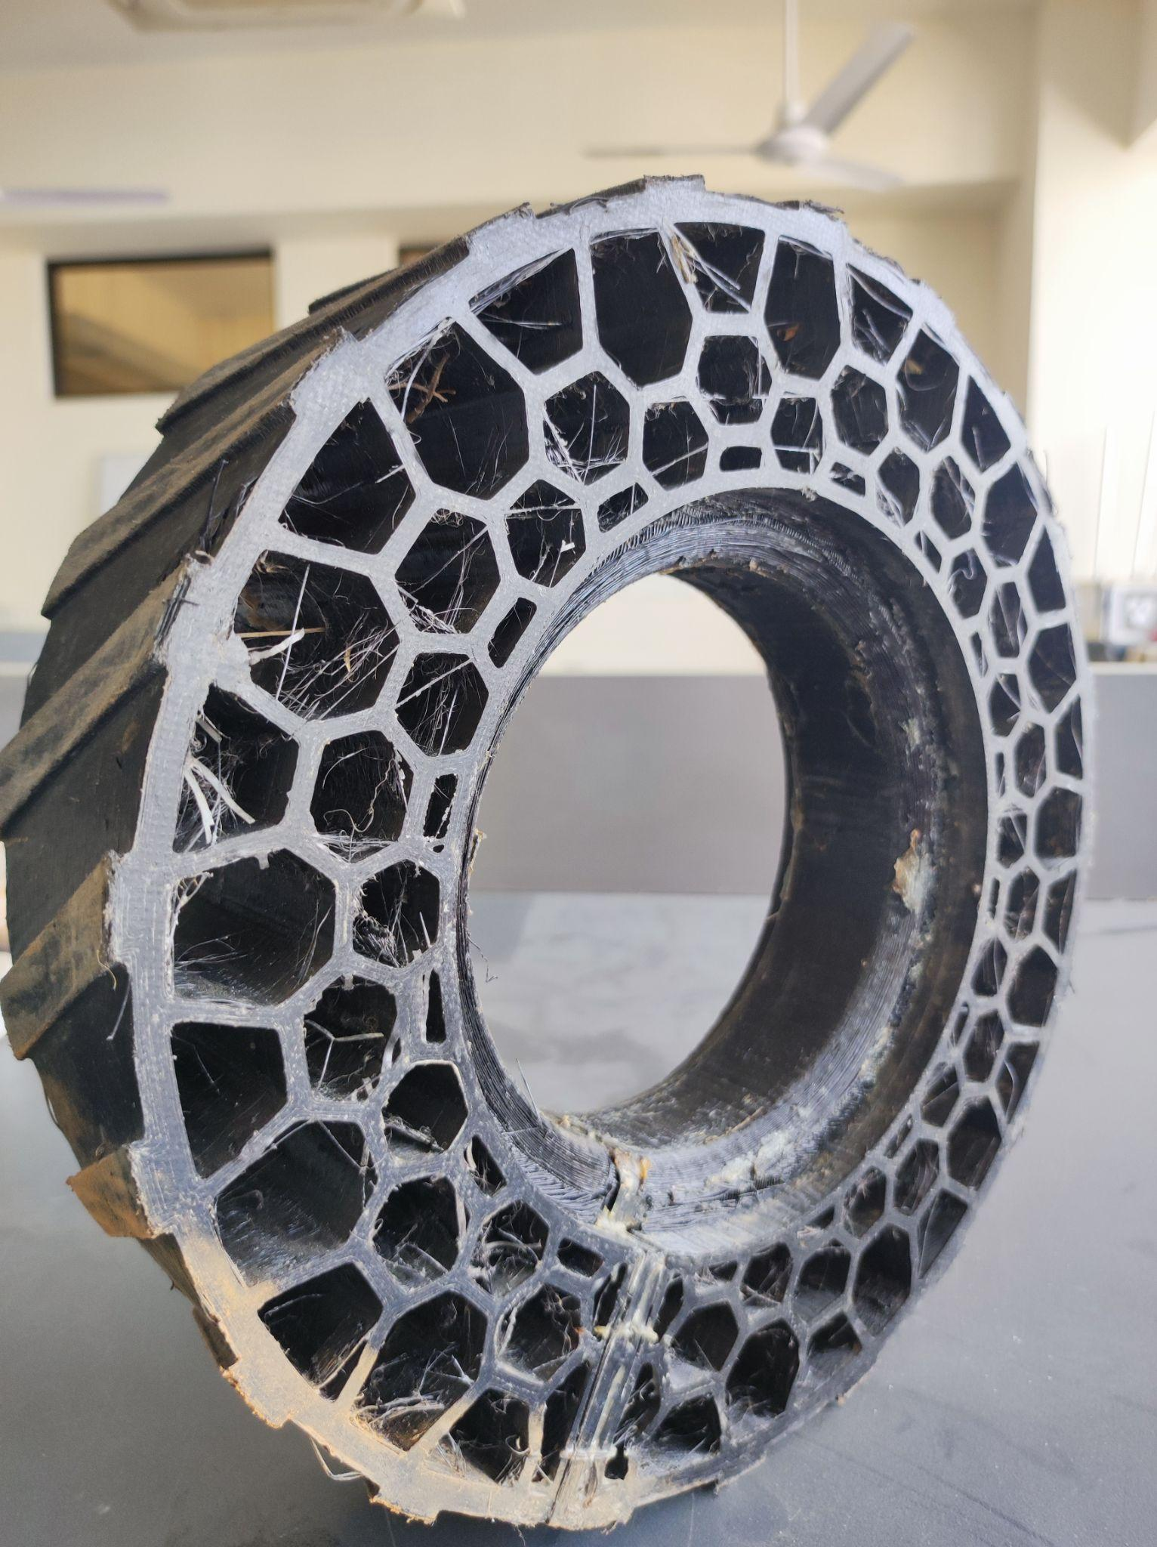
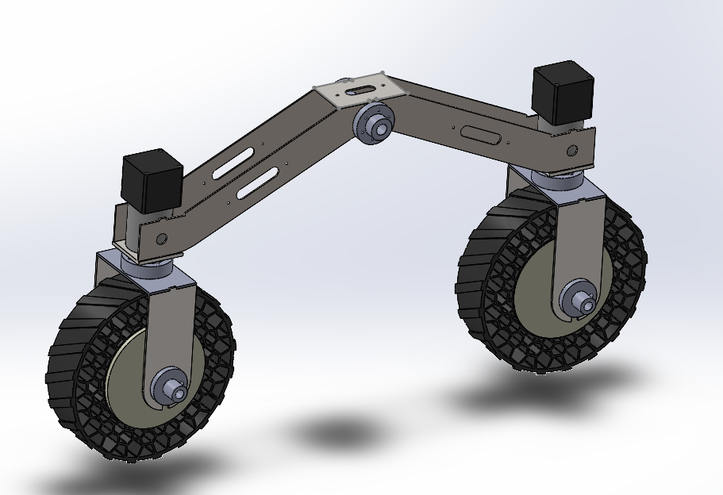
ROVER DESIGN
Mobility
System:

Slide 17
ROVER DESIGN
Mobility
System:
Phoenix 3.0 weighs 50 kg in total.
The full rover size is 87 cm x 86 cm.
The chassis is 55 cm x 45 cm x 15 cm in dimension.
The diameter of the wheel is 23 cm.
The rover is well equipped with better suspension and shock absorption. It can swiftly move through rough terrain and climb through elevations without any complication. It is also capable enough to move through narrow spaces without crashing or causing any kind of damage. Additionally, The rover can precisely move along a line of path.

Slide 18
ROVER DESIGN
The rover is powered by 9 Li-po batteries. Four battery is used for arm circuit , three battery is used for wheel circuit and two battery is used for logic circuit and cooling system. The wheel motor , stepper and encoder power circuit runs on 36V , arm power circuit runs on 24V and microcontrollers , coolers, computer , camera, communication are powered with 12V. Each circuit uses custom PCBs.The modular architecture of the electronics subsystem is implemented by simulating the real time electrical circuits of the rover using custom-designed PCBs and Solidworks Electrical 3D.
Electronics and power system:
The electronic subsystem is isolated into two modules to support quick and easy plug and play. Thus a particular module only needs to be connected to the rover in order to be configured and to function perfectly, without affecting the remaining modules during the changing of electrical components in the mission. Basically, the modular architecture ensures portability, reduced maintenance time and easier fault detection.

Slide 19
ROVER DESIGN
A voltage stabilizer system is used in the power supply which shuts down the excess voltage from being applied to the components.
Several temperature sensor is implemented throughout the system and temperature is being monitored always. Whenever the temperature rises to a certain level (a level which is marked as dangerous) the system will shut down automatically and indicates it with LED.
Several Cooling fan is used in the body such that it can maintain optimum temperature while heavy usage.
If there is any sub-system that is consuming power while not functioning it will be shown in the dashboard which will be switched off from the control panel.
Rover safety is ensured by implementing a fail-safe in the code allowing remote shutdown of all rover operations.
Kill switch is introduced to stop rover at any emergency.
Electronics and power system:

Slide 20
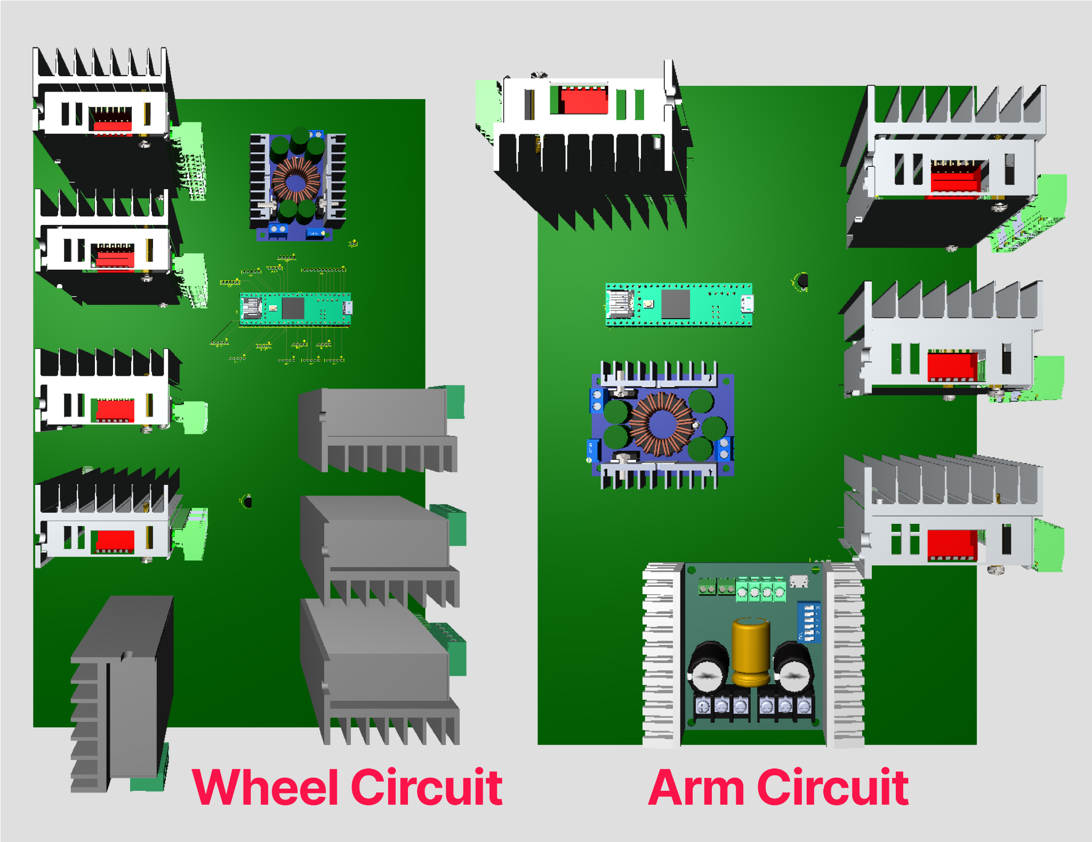
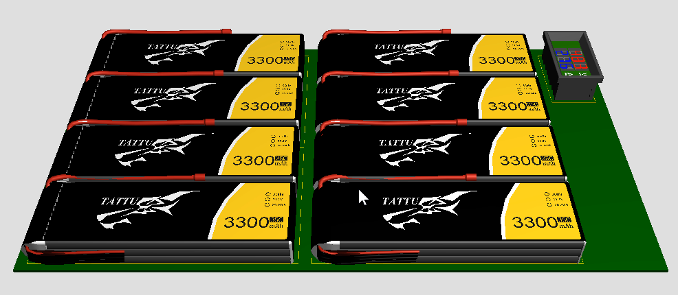
ROVER DESIGN
Electronics and power system:

Slide 21
ROVER DESIGN
 | Wheel Circuit | Arm Circuit | Logic Circuit
Voltage | 36V (12V+12V+12V) | 24V ((12V+12V)||(12V+12V)) | 12V (12V||12V)
Capacity | 5000mAh | 10000mAh | 10000mAh
Technology | 3S Li-Po | 3S Li-Po | 3S Li-Po
Weight | 3x378gm | 4x378gm | 2x378gm
Operating Time | 34-45 minutes | 50 minutes
Electronics and power system:
The longest mission duration is 60 minute, our rover wheel can continuously rotate for 45 minutes at full power which is more than enough for any mission. In addition, our arm can function at full power for 50 minutes, so our system is quite good for accomplishment of any kind of ARC mission. Our System is designed such that the electronic components would not be harmed during rough terrain traversal.

Slide 22
ROVER DESIGN
Manipulation system:
For gripping, the optimum claw was designed by testing various geometrical shapes. A worm gear is used to dispatch a tight grip to the claws.
Carbon Fiber has been used in an arm link as it has a high strength-to-weight ratio that reduces the overall weight of the arm. The precise length of the arm link is connected with an actuator to increase the pulling capability of the arm.

Slide 23
ROVER DESIGN
Manipulation system:
Carbon fibre material has been used to link the building materials. Inspired from F1 racing cars chassis material
Spur Gear is used in the arm base for precise waist motion
Bevel gear mechanism has been used in end effector to get two different motions from a single mechanism. Inspired from car’s differential housing
A wide range of work envelopes to complete tasks easily
Custom made bearing housing and 3D printed spacer for link joints

Slide 24
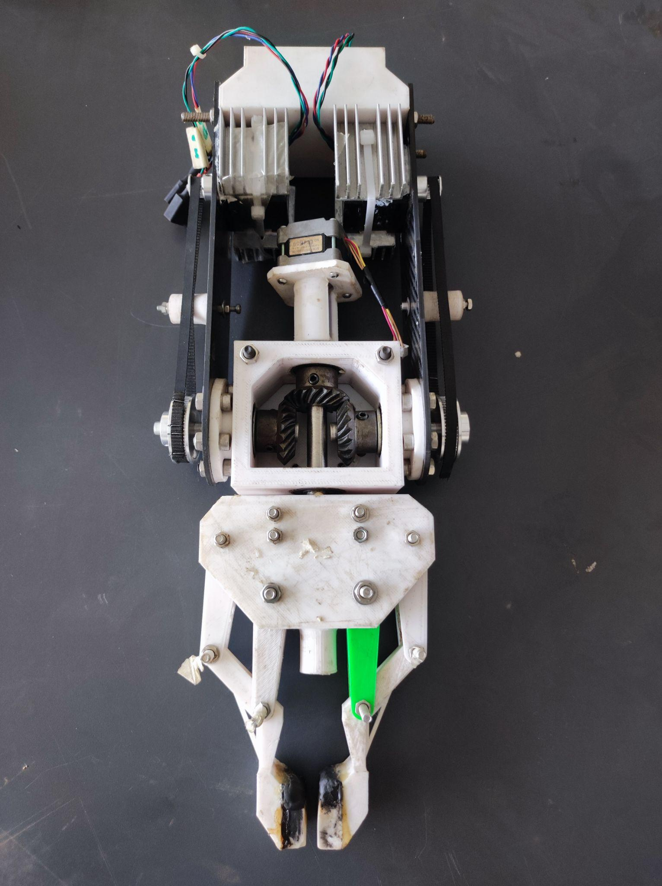
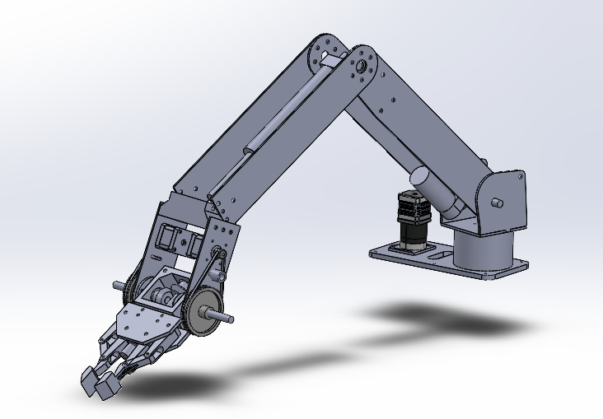
ROVER DESIGN
Manipulation system:

Slide 25
ROVER DESIGN
Manipulation system:
Mass: 8.5 kg
Max payload: 6 kg
Max reachable height: 1340 mm
Operating Radius: 830 mm
It has a 5 Degrees of Freedom (DOF) articulated arm designed with inverse kinematics. Various gear ratios were tested to verify the prescribed waist motion for precision and optimum claw structure with spur gear of 5:1 ratio in the arm base for precise waist motion and worm gear to dispatch tight grip to the claws.

Slide 26
ROVER DESIGN
Science Payload:
The science payload of our rover tests two different kinds of samples- soil and rock, by collecting data and images, which are then processed to classify the presence of extant or extinct life or absence of life. A specialised gripper at the end of the manipulator collects and deposits soil from the sampling sites to the beakers onboard the rover, while different kinds of sensors present in the mechanism measure the physical characteristics of the soil. Rock samples are closely inspected via the USB microscope and the sensors present, and images are captured using a high-resolution camera, which are sent to the dashboard after processing, for further analysis.

Slide 27
ROVER DESIGN
Science Payload:
The system was chosen for its ability to collect multiple soil samples while ensuring minimal cross-contamination, and process data and images collected from rock samples in order to determine the presence of life in the rock and soil samples, including extinct, extant, and no presence of life. In soil sample analysis, the system can collect multiple samples from different sampling sites, using methods that are cost-effective, less complicated, less time-consuming, and equipment that is basic, lightweight, and compatible with the rover systems. The analysis of rock samples is based heavily on a machine learning approach, as opposed to the traditional mineral detection approach which relies solely on user knowledge. This makes the system more reliable and accurate. Despite its shortcomings owing to the lack of direct manipulation of the surface of the rock specimen by applying any reagent or conducting any test since only image analysis and mVOC sensors are used herein.

Slide 28
ROVER DESIGN
Science Payload:
The rover uses a 5 DOF arm with a specialized gripper to collect soil samples, which penetrates a minimum depth of 10cm underground. A testing chamber has been mounted on the back of the rover containing 9 beakers for contamination-free sample storage, and distilled water along with a pH sensor to measure the soil pH. The samples, along with data collected by onboard soil moisture and temperature, wind speed, and radiation sensors, are to be sent back to the base station for immediate transportation and evaluation. USB microscope feedback and images of the rock samples captured by the camera are fed into Jetson nano, where we have used VGG-16 as the transfer learning model, with our custom dataset of 8139 rock samples, to tune the DNN model for predicting the type of rocks and further classification. Moreover, a Munsell chart is used to detect the level of total organic carbon present in rock samples by analyzing the data collected by the colour sensor onboard.

Slide 29
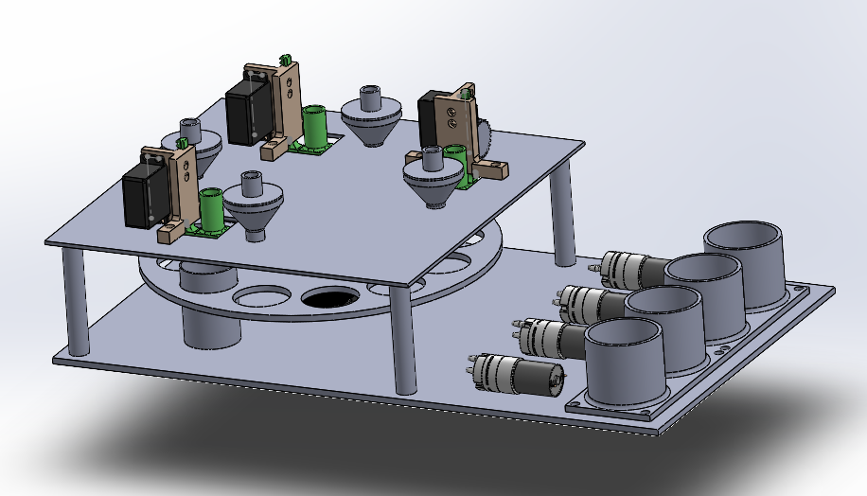
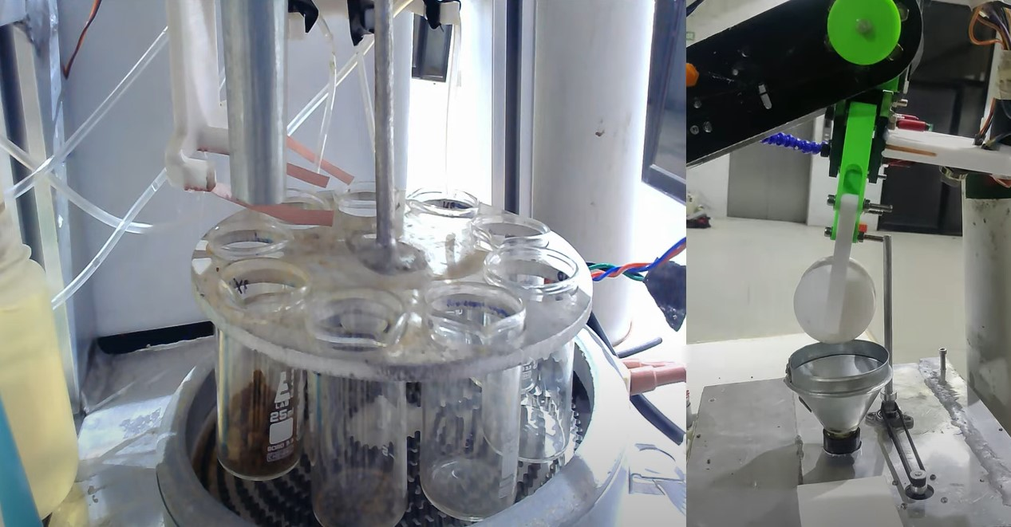
ROVER DESIGN
Science Payload:

Slide 30
ROVER DESIGN
Science Payload:
In the science payload, the arm used to collect soil from the sampling site has 5 degrees of freedom, which provides the rover with better motion capabilities and precision. The testing chamber is a 300 mm x 300 mm x 100 mm aluminium box containing 9 beakers and a reagent bottle containing distilled water, weighing 1 kg with a height of 100 mm. The soil sample collection payload of the rover contains a USB camera, a panoramic USB camera, and several sensors e.g. soil moisture/humidity, temperature, wind speed, and radiation sensors to form a better idea of the designated sampling site. Again, the rock sample analysis mechanism contains a USB Microscope, mVOC sensors detecting alcohol, aldehyde, ammonia, and carbon dioxide, and a colour sensor to detect the presence of extant or extinct lives or the absence of life on the surface of the specimen. The sensor board of the rock sample analysis mechanism contributes 205 g to the total weight of the science payload.

Slide 31
ROVER DESIGN
Science Payload:
The science payload of the rover is considered to be sufficiently well-equipped in perspective of the mission requirements. This mechanism can successfully collect and transport soil samples, and sensor and camera data from the sampling site to the Mars Base to the rocket (for Mission 1), ensuring minimal contamination of samples and corruption of data. Additionally, a USB camera mounted on the rover captures stratigraphic photographs of the area, and also photographs of the sampling site, while the panoramic photographs are captured by the panoramic USB camera. Ignoring minor limitations that may lead to slightly less-than-perfect results in the mission, the science mechanism for collection and analysis of soil and rock specimens by using transporting and processing methods both onboard the rover and engineered into its software can be deemed foolproof and adequate for the completion of the required tasks.

Slide 32
ROVER DESIGN
Ground station equipment and communication system:
The ground station consists of 3 feedback monitors, transmitting antenna and rover controller. 3 separate transmitting antennas have been used for 3 different bands.
The communication system features various bands for different functions, such as 2.4 GHz for extended transmission, 5.8 GHz for video streaming, and a 1.2 GHz band as a backup for the 5.8 GHz band. A significant drawback of this system is its high latency over long distances, with a maximum range of 1 km. If the 5.8 GHz connection is lost, a 1.2 GHz FPV camera takes over for video feedback. When the 2.4 GHz connection is disrupted, data reception halts, and all information is temporarily stored in a device until the connection is restored, at which point the data is transmitted.

Slide 33
ROVER DESIGN
Ground station equipment and communication system:
In the event of a connection failure, the system retains sensor data as a backup. During communication disruptions, the rover comes to a halt and patiently awaits the restoration of the connection.

Slide 34
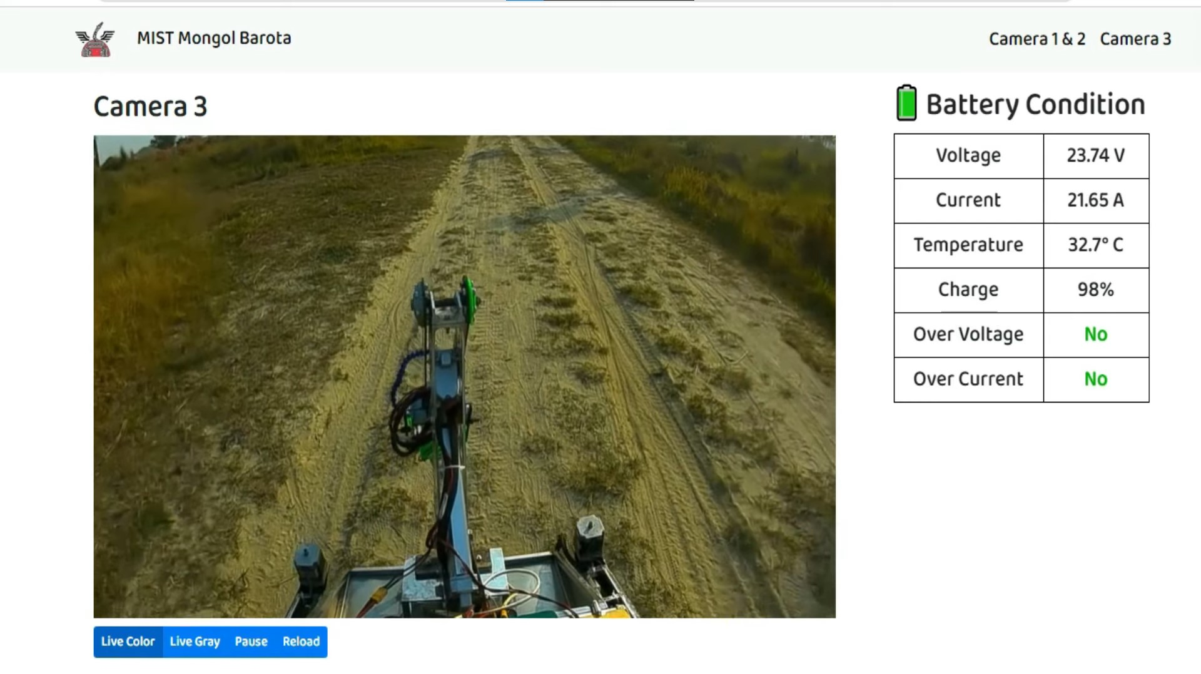
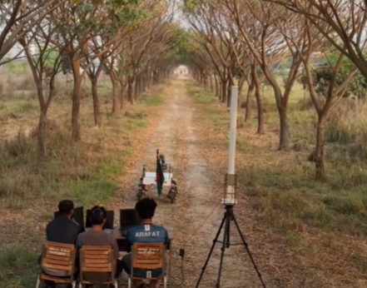
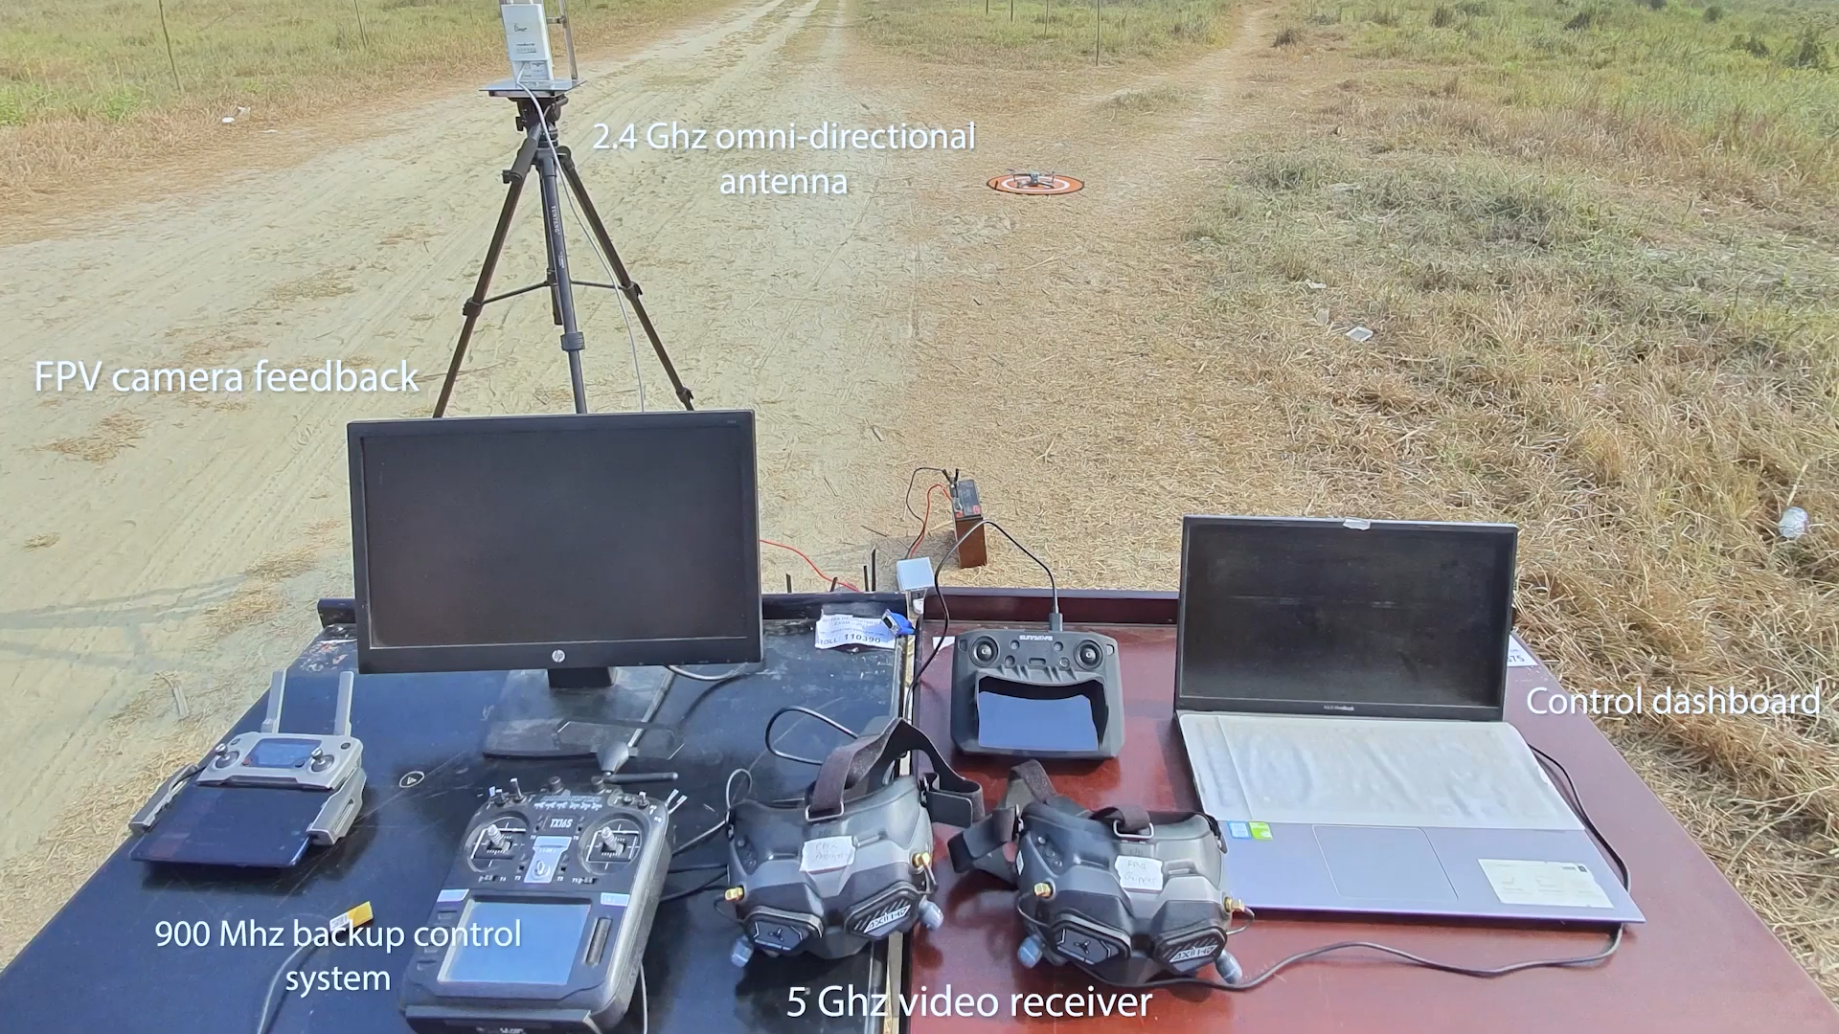
ROVER DESIGN
Ground station equipment and communication system:

Slide 35
ROVER DESIGN
Ground station equipment and communication system:
The communication system uses three distinct bands for communication. The 2.4 GHz (ISM) band is utilized for data and command transmission, the 5.8 GHz (ISM) band is designated for video transmission. And the 1.2GHz band has been used for backup video transmission.
The system provides lag free video, data and command transmission for monitoring and controlling of the rover in real time.

